Slide 1
What’s wrong with this data visualization?
Adapted for CGT 2700 Data Visualization
Group 4

Slide 2
Group 4
Group Members
Instructions
List the names of each group member here <list each name on a separate line>
Tyrone Beladja
Saswat Mishra
Renee Chang
Bethany MaGee
List the name of the scribe here.
Saswat Mishra
Examine the visualization on the next slide
Determine what’s wrong with the visualization
Then, provide recommendations on how the group would REFINE the visualization
Use any of the resources mentioned in previous lectures and readings

Slide 3
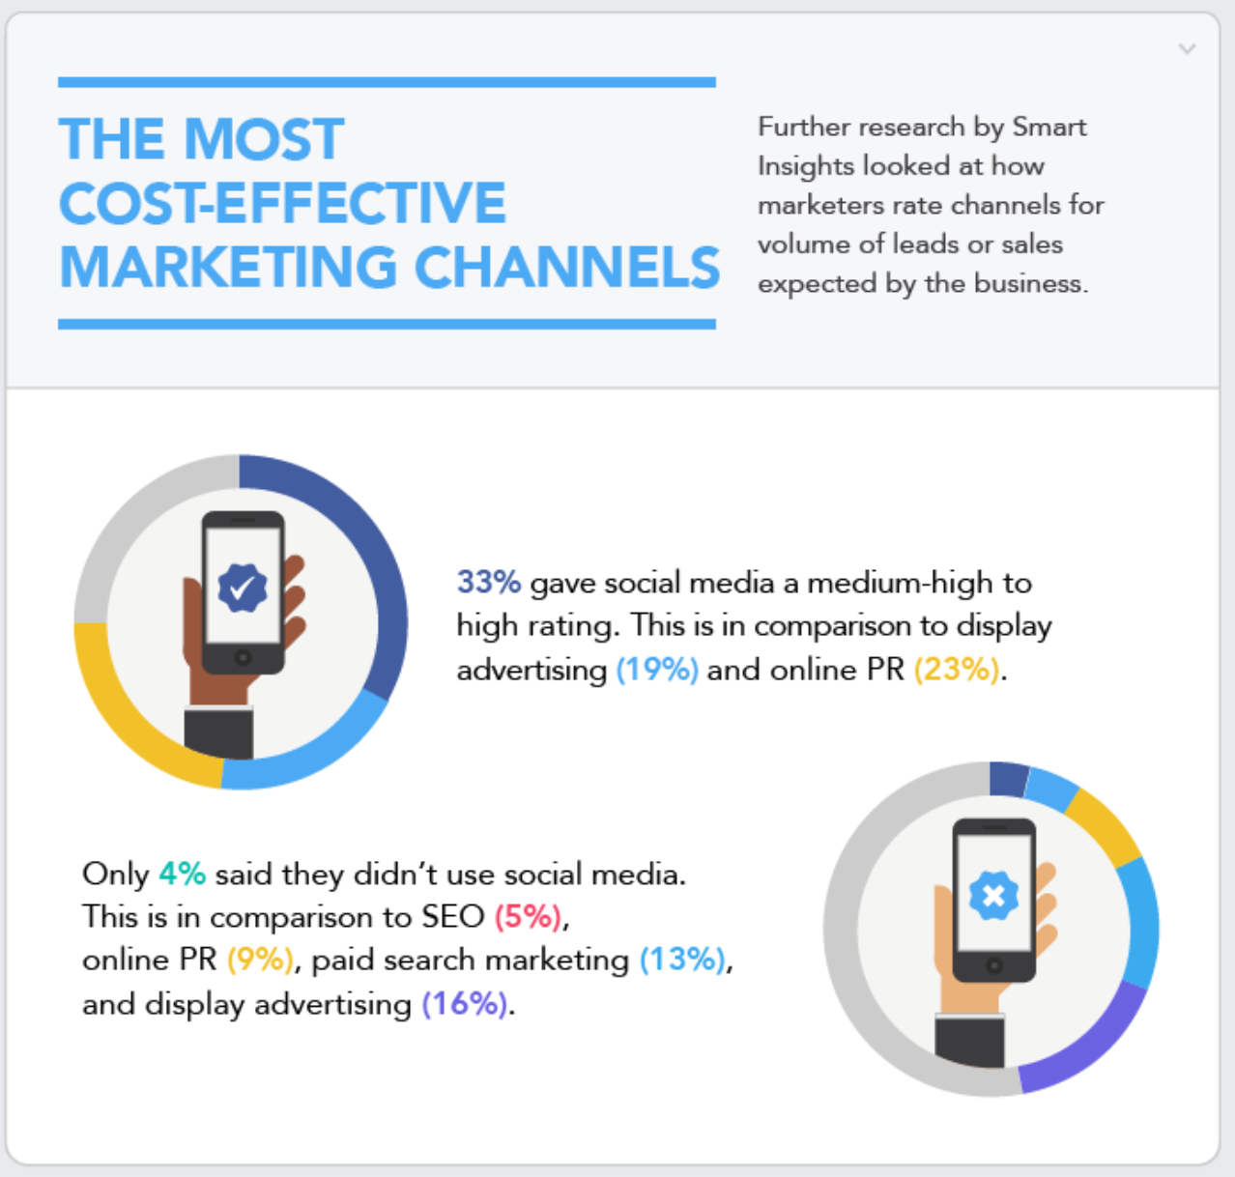

Slide 4
What is it?
This graphic was created by a company named JBH, who by the way, create infographics for a living.

Slide 5
What’s wrong with it?
It doesn’t state where the percentages come from
It would be better as a Pie Chart
The colors on the chart doesn’t match with the percentages
On the Pie chart, there isn’t a Legend

Slide 6
What should they have done?
Make a legend so that the chart makes more sense
Make the chart more clear
Use the right colors when discussing the percentages
Make the title more accurate

